Slide 1

OPTIONS ASSESSMENT
Lucinda Jetty Remediation
Access Methodology
Prepared for Sugar Terminals Limited
ED-018-2026-03 Rev B | 26 August 2026 | Commercial in confidence
From liability to closure.

Slide 2
THE BRIEF
Why STL commissioned this assessment
Endura Decommissioning was engaged to assess how access is provided to the remediation, and to recommend a method that finishes by end 2028.
227 priority bents must clear within the 2027 and 2028 working seasons.
That requires 4.5 completed bents a week.
The works are delivering well under one bent a week.
The gap is not workmanship. It is the access method: scaffold erected, encapsulated, dismantled and rebuilt at every bent.
This assessment changes how crews reach the work, not what the work is.
The welding, blasting, coating and jackets, and the crews and contract rates that do them, are unchanged throughout.
Commercial in confidence | Endura Decommissioning | ED-018-2026-03 | Rev B
2

Slide 3
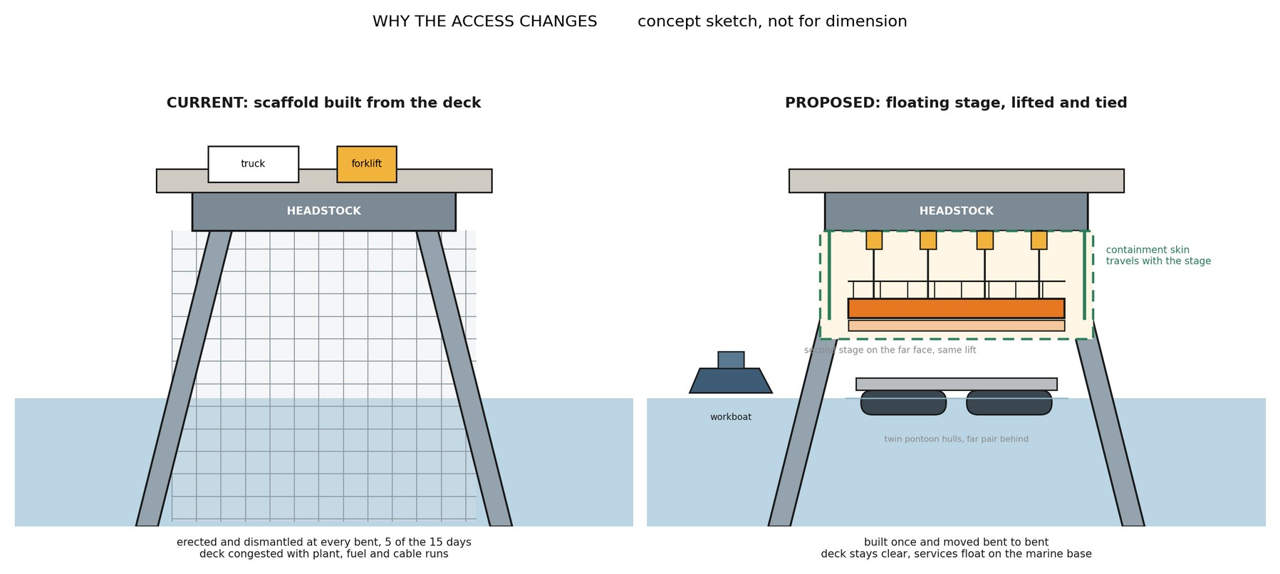
THE PROBLEM
The current method has a ceiling
A scaffold bent takes 15 to 16 working days, and only about half of that is trade work.
The access is rebuilt at every bent, 227 times.
Erection, encapsulation, the engineering approval hold, dismantling, then again at the next bent.
In practice the site holds near five scaffold crews.
Single welding and blasting spiders and a single lane 8 tonne roadway limit adding more.
Even five uninterrupted fronts deliver 1.3 to 1.7 bents a week.
Reaching 4.5 would take 14 to 18 simultaneous scaffold fronts, which the structure cannot host. The ceiling belongs to the method, not to any contractor.
Commercial in confidence | Endura Decommissioning | ED-018-2026-03 | Rev B
3

Slide 4
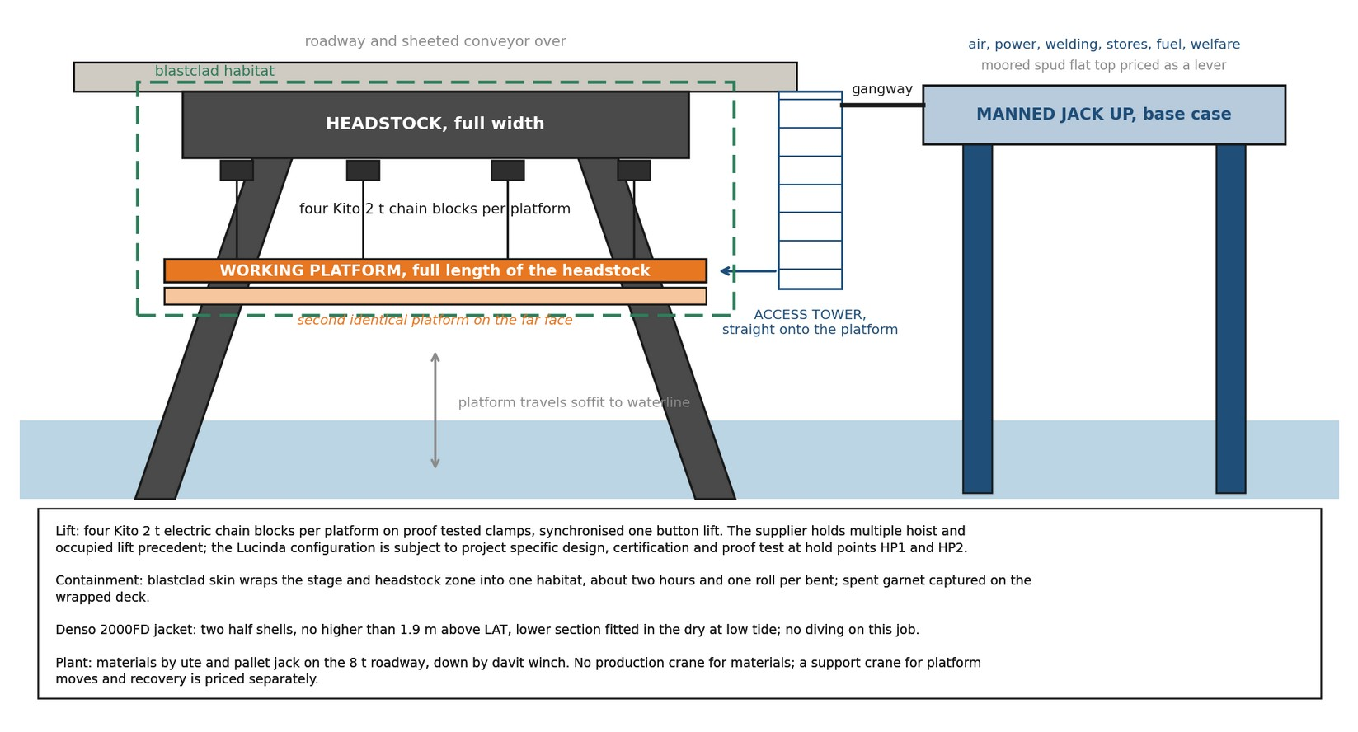
THE METHOD
Build the access once, move it 227 times
Floating stages lifted on synchronised chain blocks, served by a floating marine base.
Work platforms float to each bent and lift clear of the tide.
Four 2 tonne electric chain blocks per stage, synchronised, third party certified for man riding. At height the stage ties to the structure and becomes a fixed workplace.
Containment travels with the stage.
Two hours and one roll per bent; spent abrasive and debris recovered from the wrapped deck.
A small jack up barge is the floating services hub.
Power, air, stores, fuel, welfare and materials a gangway from the work face, keeping the roadway clear.
Commercial in confidence | Endura Decommissioning | ED-018-2026-03 | Rev B
4

Slide 5
COMMERCIAL
What it delivers, and what it costs
Access provision at concept stage with 25 percent contingency. Every figure computes in the companion model.
 | Current scaffold | Day shift, recommended | Extended hours, if approved
Delivery rate, bents per week | well under 1 | 4.5 to 4.7 | 4.5 to 4.7
Access provision | $9.24M allowed in the schedule | $16.04M | 8 fronts | $14.22M | 5 fronts
Completion | does not finish | October 2028 | October 2028
About $6.8M of additional access buys the outcome: a job that finishes inside the deadline.
The optimisation path, principally the marine base choice and its wet season arrangements, brings the day shift provision toward about $11.3M as quotations firm.
Commercial in confidence | Endura Decommissioning | ED-018-2026-03 | Rev B
5

Slide 6
WORKING PATTERNS
Day shift stands on its own; extended hours add value
Day shift reflects STL’s stated preference. The written approvals position is a decision gate, not an assumption.
 | Day shift | 0600 to 2200 pattern | Extended hours
Work fronts | 8 | 6 | 5
Access provision | $16.04M | $13.95M | $14.22M
Approvals needed | none beyond current | evening extension; overnight never entered | night working variation
All marine work stays in daylight in every pattern.
After dark, trades work only on platforms already lifted, tied and secured as fixed plant, inside the lit, enclosed habitat, with standby cover on the water.
Commercial in confidence | Endura Decommissioning | ED-018-2026-03 | Rev B
6

Slide 7
THE MARINE BASE
One line, priced every way
The largest single line, about $4.3M before contingency, so it is presented as a choice with evidence.
Arrangement | What it means | Fronts | Access $M | Finish
No marine base | All services from the wharf; crews travel the roadway for every need; a ninth front covers the lost hour each shift | 9 | 12.49 | late Sep 2028
Jack up barge, whole campaign | The carried, conservative case | 8 | 16.04 | 11 Oct 2028
Same, serviced productivity | The half to one shift a bent the base returns, priced in | 8 | 15.34 | 17 Sep 2028
Barge in Zone 3 only, season one | Base holds the exposed outer water where draft demands it; season two shore serviced | 8 | 14.68 | 23 Oct 2028
Zone 3 season one on a moored spud | As above with a cheaper moored barge for season one | 8 | 13.08 | 23 Oct 2028
Moored spud, whole campaign | Same services at a lower day rate; rough weather boarding is the trade off | 8 | 12.26 | 11 Oct 2028
Without the base: $3.55M saved on paper, a ninth front and an hour of every shift lost. Real net cost of keeping it: $2.1M to $2.8M.
Commercial in confidence | Endura Decommissioning | ED-018-2026-03 | Rev B
7

Slide 8
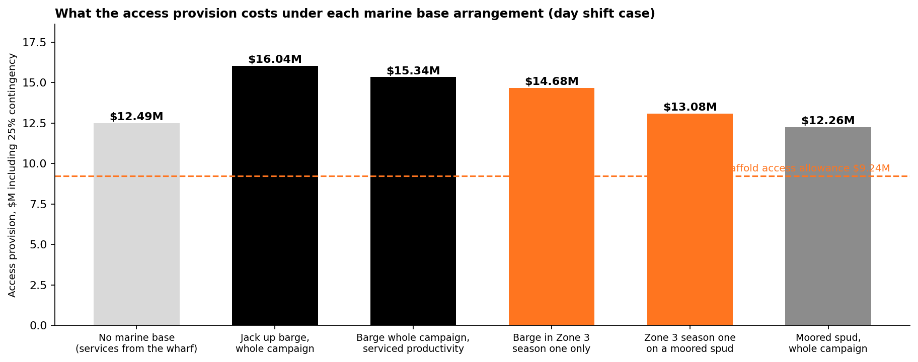
THE MARINE BASE
Access cost by arrangement
Commercial in confidence | Endura Decommissioning | ED-018-2026-03 | Rev B
8

Slide 9
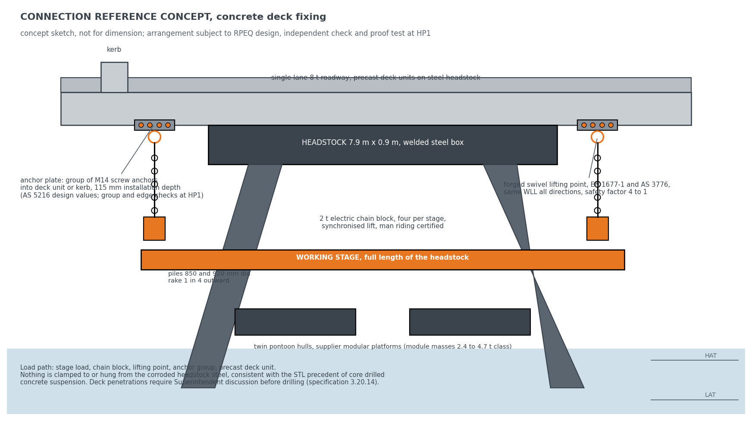
VERIFICATION
How it connects to the structure
The corroded headstock steel, the member being remediated, carries nothing.
The load path runs through the precast concrete roadway and kerb.
Groups of M14 screw anchors carrying forged swivel lifting points, consistent with previous over water works at the terminal.
The strength is proven, not assumed.
Registered professional engineer design with independent check, third party man riding certification, and a proof load test at every anchor point one bent ahead.
The certified precedent runs the same hoisting system at under half its rated load.
The supplier’s Lucinda methodology and lift plan follow as an annex.
Commercial in confidence | Endura Decommissioning | ED-018-2026-03 | Rev B
9

Slide 10
VERIFICATION
Why a stage cannot simply fall
Layered, independent controls, each proven before anyone relies on it.
Four braked hoists share every lift, each under half its rated load.
The group holds the stage with margin even with one hoist discounted.
Every anchor point is proof load tested one bent ahead.
Before any load, and before any person steps on.
Lifting is the exception, not the norm.
At working height the stage transfers onto positive ties and the hoists come off load; the blocks carry load only while travelling between bents.
Crews are off the stage for every lift; a rescue craft is on the water whenever crews work over it.
No single failure lowers a stage.
Commercial in confidence | Endura Decommissioning | ED-018-2026-03 | Rev B
10

Slide 11
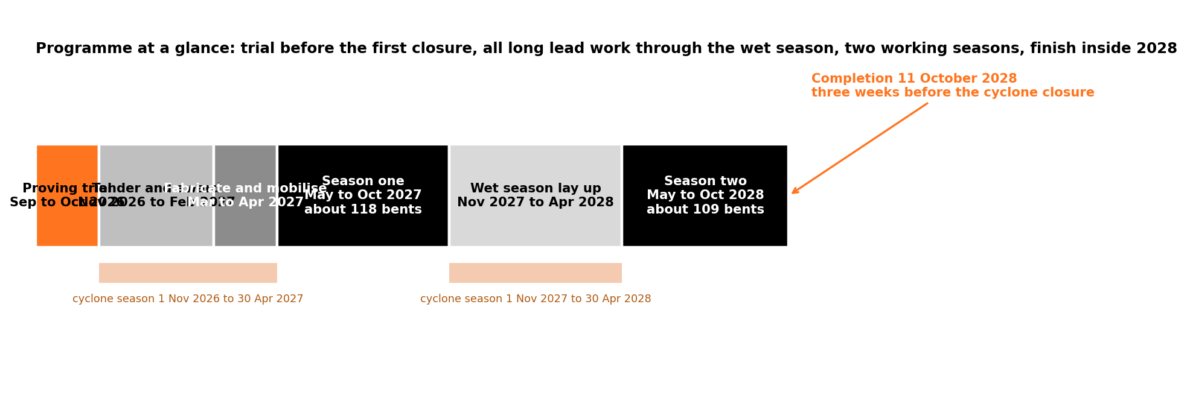
PROGRAMME
Finished with three weeks in hand
Trial before the first cyclone closure; procurement and fabrication through the wet season; two working seasons.
Modelled completion 11 October 2028, three weeks before the closure and 82 days before the end 2028 requirement.
A dated, bent by bent programme is a deliverable before any fleet order.
Commercial in confidence | Endura Decommissioning | ED-018-2026-03 | Rev B
11

Slide 12
THE GATE
The proving trial commits nothing beyond itself
Two to four weeks on the real bents, September and October 2026, $350,000 to $600,000.
The supplier’s five existing platforms, a workboat, anchors installed and proof tested, containment fitted, everything measured.
One week with the marine base and one week without it.
The biggest open cost question is settled by measured cycle times.
A September start needs the STL instruction within weeks.
The signable instruction is Appendix D of the report.
Commercial in confidence | Endura Decommissioning | ED-018-2026-03 | Rev B
12

Slide 13
DECISIONS
Six decisions sought from STL
Commitment is staged: approving each step never commits the next.
1. Agree the pre approved repair detail library with the Superintendent.
Removes a standing engineering hold from every bent, at no plant cost.
2. Instruct the proving trial for September and October 2026.
Within weeks of this issue for the September window.
3. Confirm the written position on working hours.
Banks or sets aside the extended hours value on evidence.
4. Provide chart depths along the alignment, or authorise the survey.
5. Indicate the preferred marine base arrangement.
6. Provide the bent register extract confirming the scope count.
227 carried; the current register runs to 257.
Commercial in confidence | Endura Decommissioning | ED-018-2026-03 | Rev B
13

Slide 14
CLOSING
The position, plainly
The current access method cannot reach the deadline at any level of effort.
The marine method finishes in October 2028 for about $6.8M of additional access provision, with the trade works untouched.
Every material risk is priced, gated behind a hold point, or answered by the trial.
Every figure reconciles to the companion model, and the quotations behind the rates are on file.
The ask this month: the trial instruction and the repair library. Everything else follows the evidence.
Commercial in confidence | Endura Decommissioning | ED-018-2026-03 | Rev B
14

